Slide 1
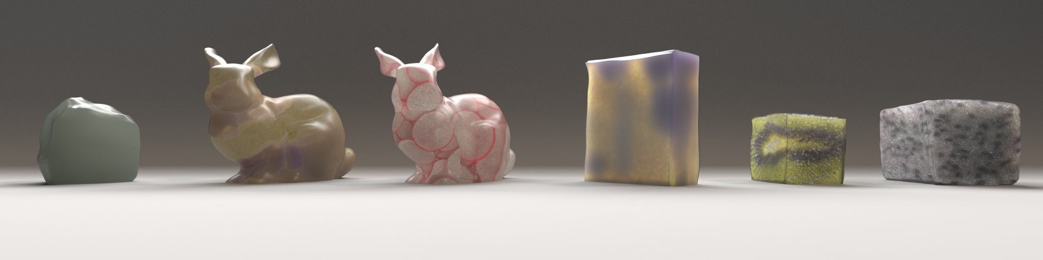
Reconstructing Translucent Objects using Differentiable Rendering(ACM SIGGRAPH 2022)
Xi Deng, Fujun Luan, Bruce Walter, Kavita Bala, Steve Marschner
Presenter:
Yiwen Mao(20236409)

Slide 2
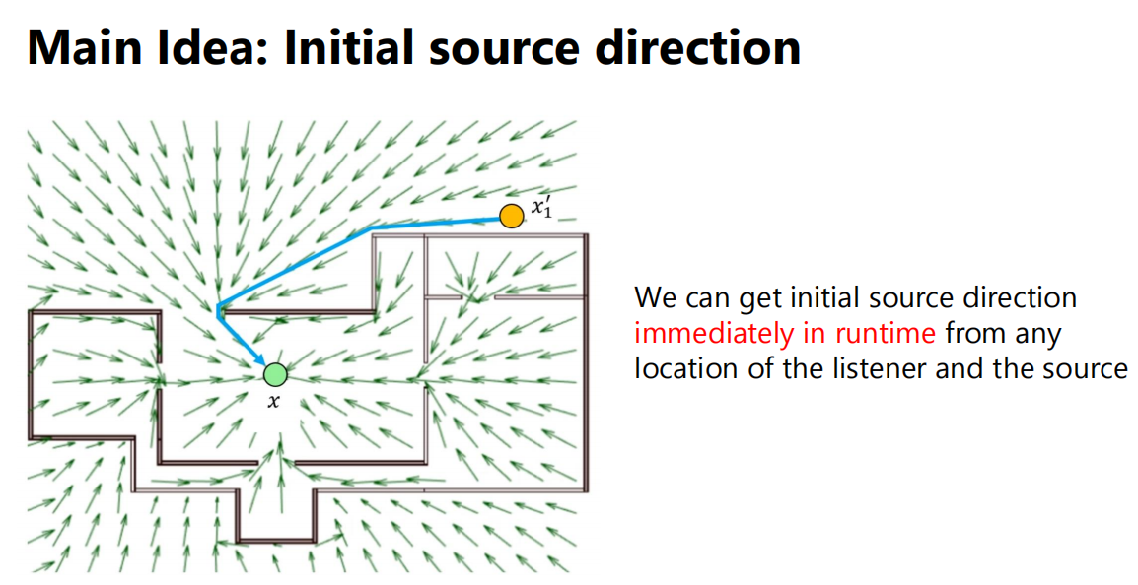
Review: Directional Sources and Listeners In Interactive Sound Propagation using Reciprocal Wave Field Coding
provide a method for real-time determination of acoustic source direction
-- Precompute initial source direction
-- Encoding reflections transfer matric
* from Ko Wonhyeok’s slides
Notes:
optimized for speed and accuracy in complex acoustic environments

Slide 3
But, what is Differentiable Rendering?
Paper Title: Reconstructing Translucent Objects using Differentiable Rendering
-- a new field which allows the gradients of 3D objects to be calculated and propagated through images
-- automatically adjust parameters through optimization algorithms
Notes:
This means that the parameters of a scene can be automatically adjusted through optimization algorithms to improve image quality or other aspects of performance. It has wide applications in fields such as computer vision, graphics, and machine learning.

Slide 4
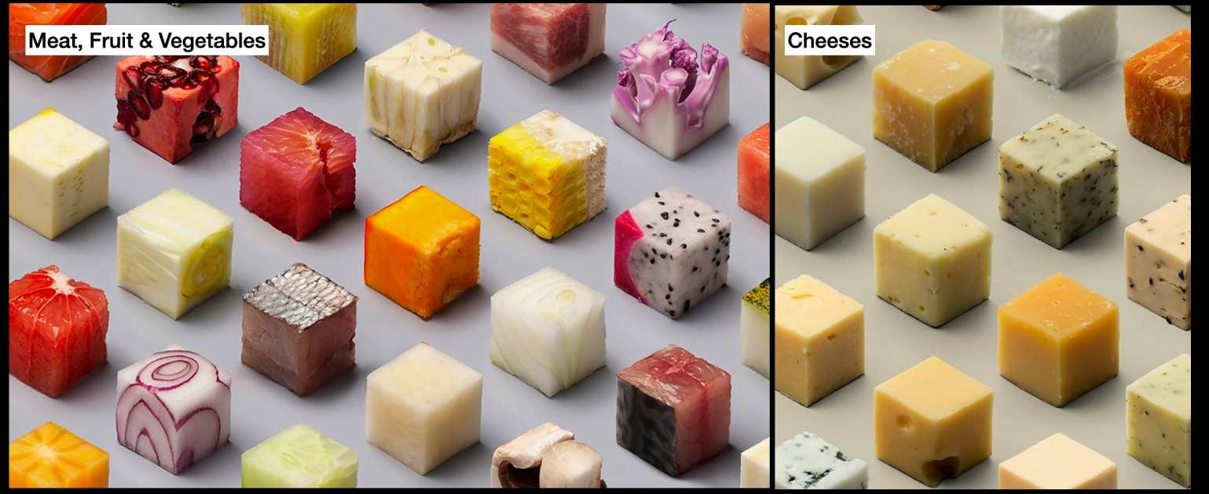
Motivation:
Translucent objects are everywhere
Photo by Studio Lernert & Sander
Notes:
food cut up into cubes.fantastic if can render this material. translucent and have so many details(hard to get)

Slide 5
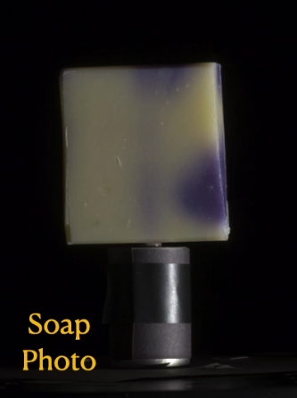

Problem Setup
Reconstruct shape and appearance from photos
Notes:
take pictures of real objects

Slide 6
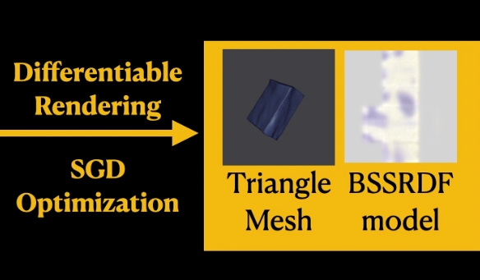
Problem Setup
Reconstruct shape and appearance from photos
Notes:
inverse rendering produce model

Slide 7
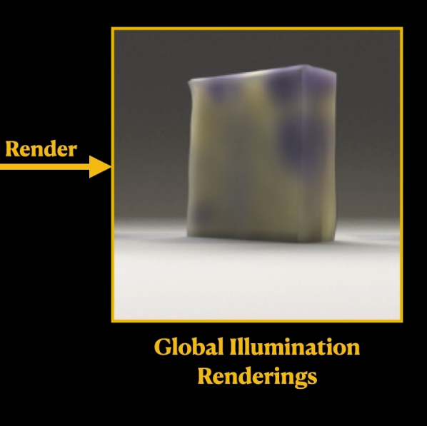
Problem Setup
Reconstruct shape and appearance from photos
Notes:
use that model in the glo.. renderer

Slide 8
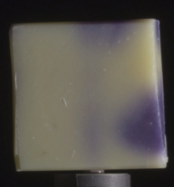
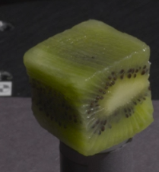
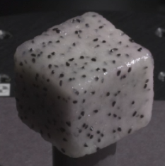
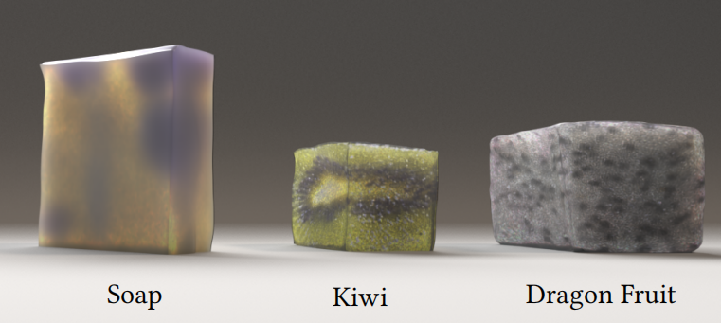
Results Preview
take photos of real object
render in global illumination

Slide 9
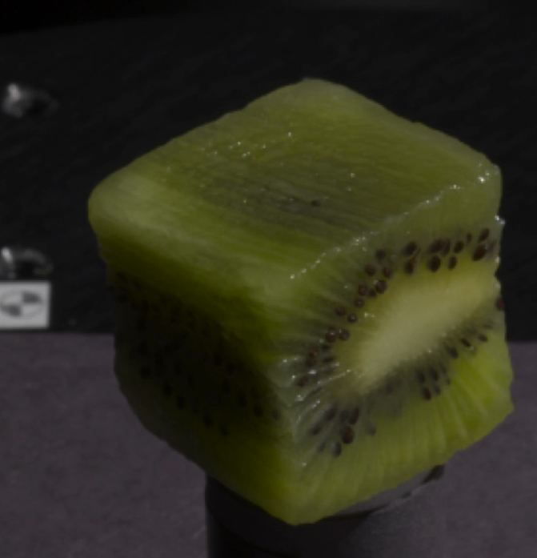
Features
1.Highly scattering objects
2.Thick objects
3.spatially varying patterns
Notes:
1.scatter many times 3.optical properties can be heterogeneous

Slide 10
Previous Work

Slide 11
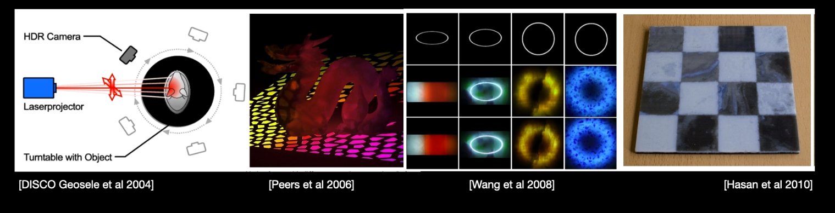
Acquisition of heterogeneous subsurface scattering material
1.Sampling with laser projector [Geosele et al 2004]
2.Factored matrix representation, projecting grid pattern
[Peers et al 2006]
3.Fit volume parameters to heterogeneous measurement
[Wang et al 2008]
4.A reflective and a transmissive scattering profile
[Hasan et al 2010]
Known Geometry, Specialized lighting, Simple model (eg. assume no Fresnel term)
Previous Work
Notes:
have tried many ways of reconstructing heterogeneous translucent object. needs 1.2.3.to solve the inverse problem

Slide 12
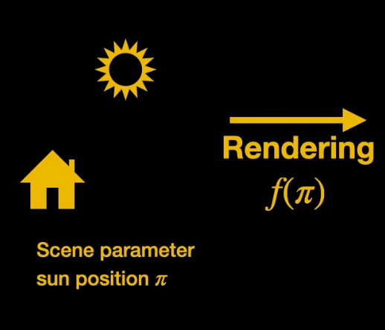
Differentiable Rendering
Previous Work
Notes:
use differentiable rendering in theme reconstruction.render function as f,pi as the input parameter

Slide 13

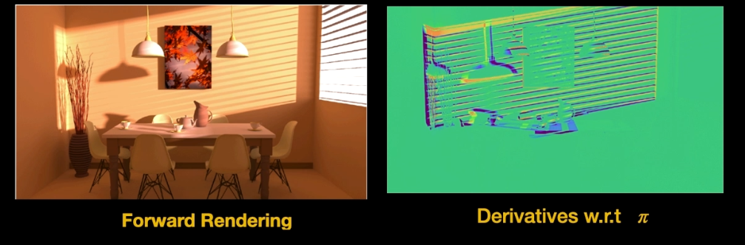
Differentiable Rendering
Previous Work
Notes:
produce the images,de re give us the derivative of this function f

Slide 14

Differentiable Rendering
Previous Work
Notes:
use derivatives ingredient descent technique to to optimize the parameter

Slide 15
Differentiable Rendering
no special shape, no special lighting
Previous Work
Notes:
doesnt need known shape/special lighting

Slide 16
Challenges
Notes:
here are some challenges in reconstructing ...

Slide 17
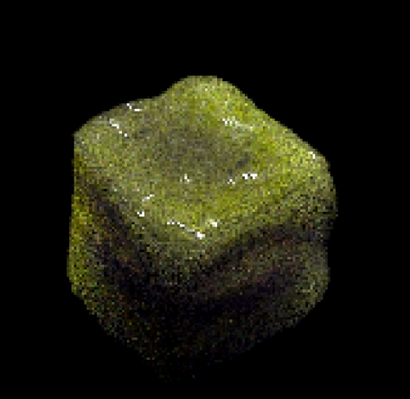
Noise / expensive rendering
Challenges
Monte carlo noise
Notes:
because of translucent things
it make our optimization tolerate a reasonable amount of noise

Slide 18
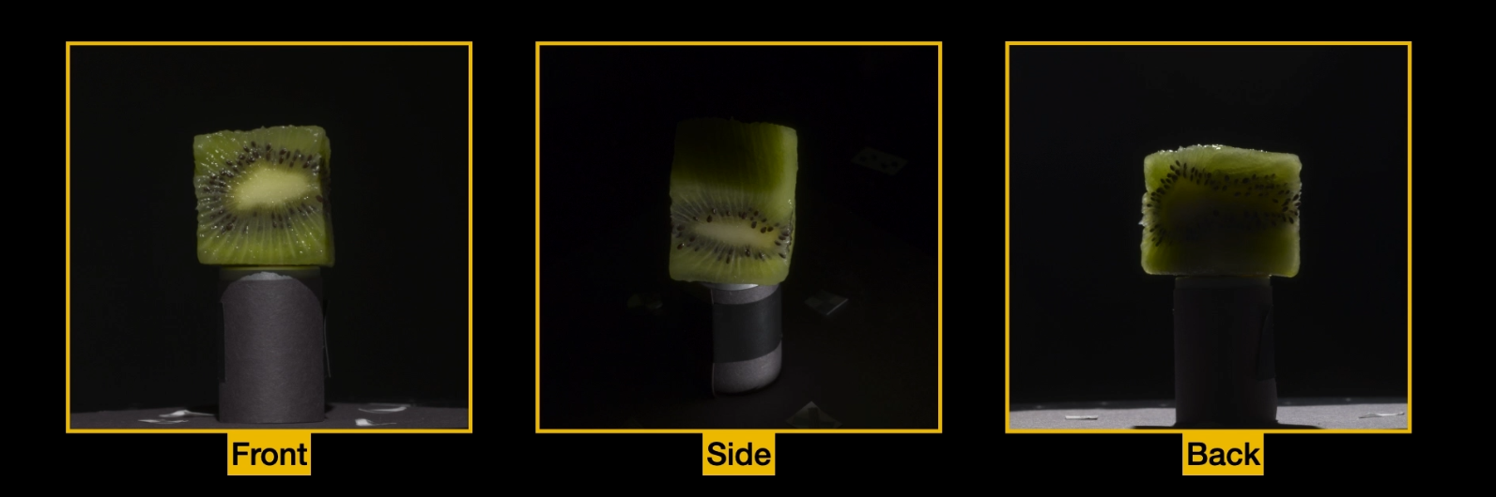
Need varied lighting and longer paths so cannot avoid shadows
Challenges
Notes:
...,so our renderer have to handle that

Slide 19
Technical approach

Slide 20
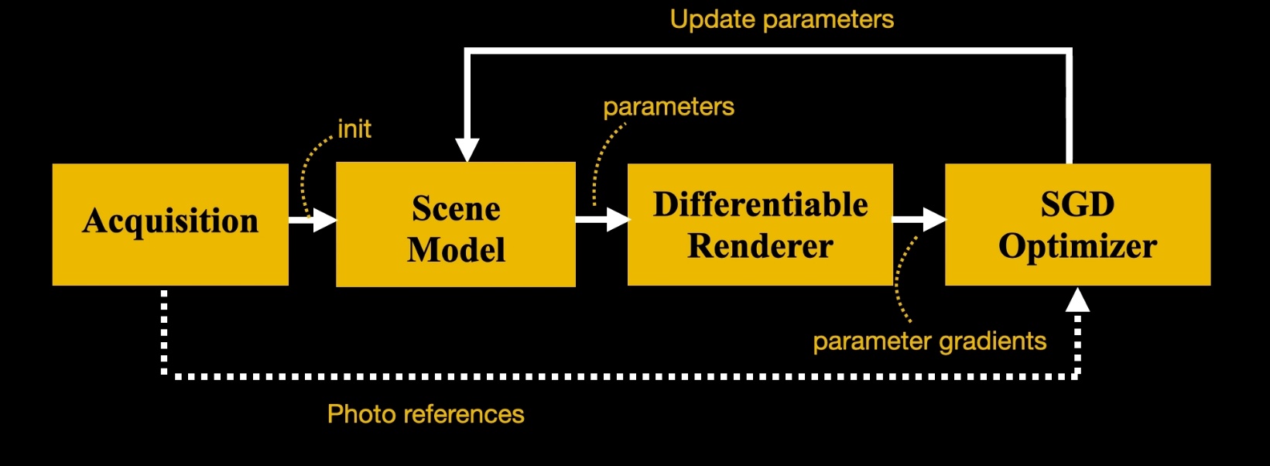
Framework
Notes:
1.we capturing images of an object through two slight camera calibrations
2.to initialize the same parameters
3.di re and SGD.. takes the photos as reference data and compute the gradients to update the same parameters
4.until parameters converges

Slide 21
Framework
Notes:
Let’s take a quick look at this section

Slide 22
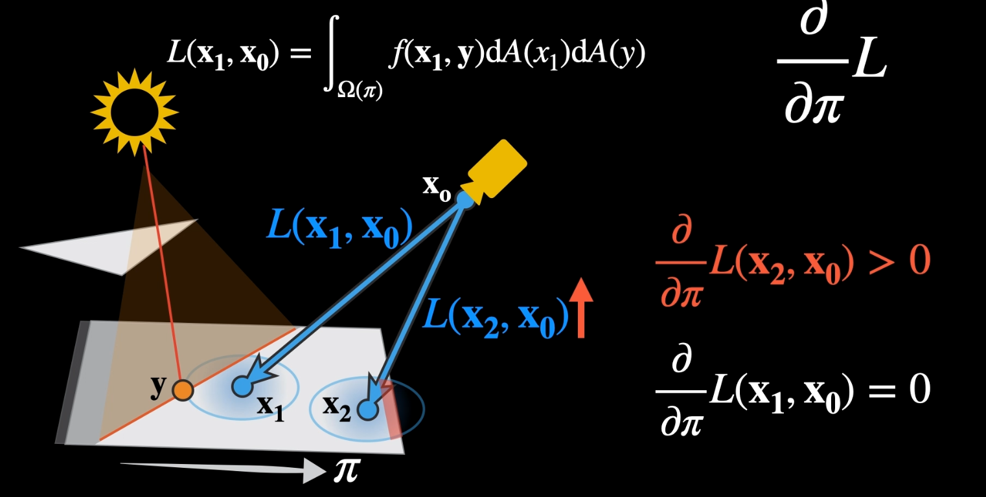
Differentiable Rendering
Notes:
incoming Radiance becomes strong so the derivative will be positive at X2,
however the incoming Radiance at x1 didnt change ,so the de.. will be zero

Slide 23
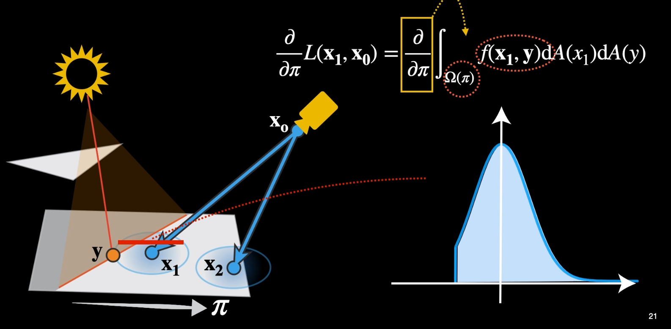
Differentiable Rendering
Notes:
1.derive the formula of computing the derivatives of L with respect to Pi
2.we find the integration domain is changing with respect to Pi
3.if we look at the slice of the integrant function near X1， it is discontinuous due to the visibility change across the shadow

Slide 24
Differentiable Rendering
No!
Notes:
4.therefore we cannot directly move this operator into the integrant

Slide 25
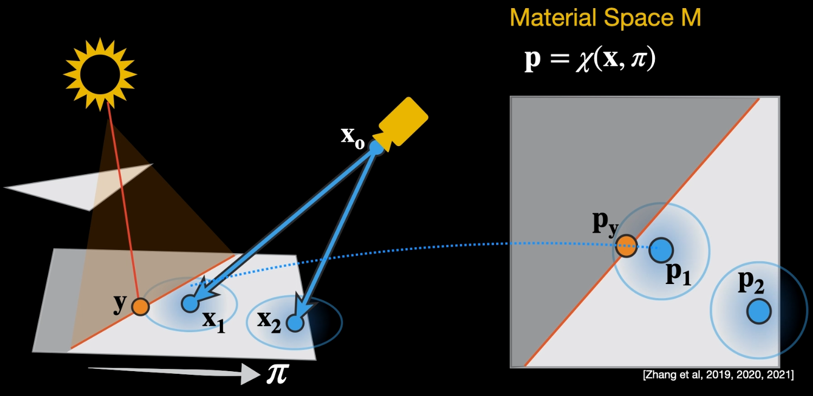
Material Space
Notes:
material space m： is a space that attached to the geometry so that when
the geometry move the Domin doesn't change
intergration domain doesn't depend on Pi

Slide 26
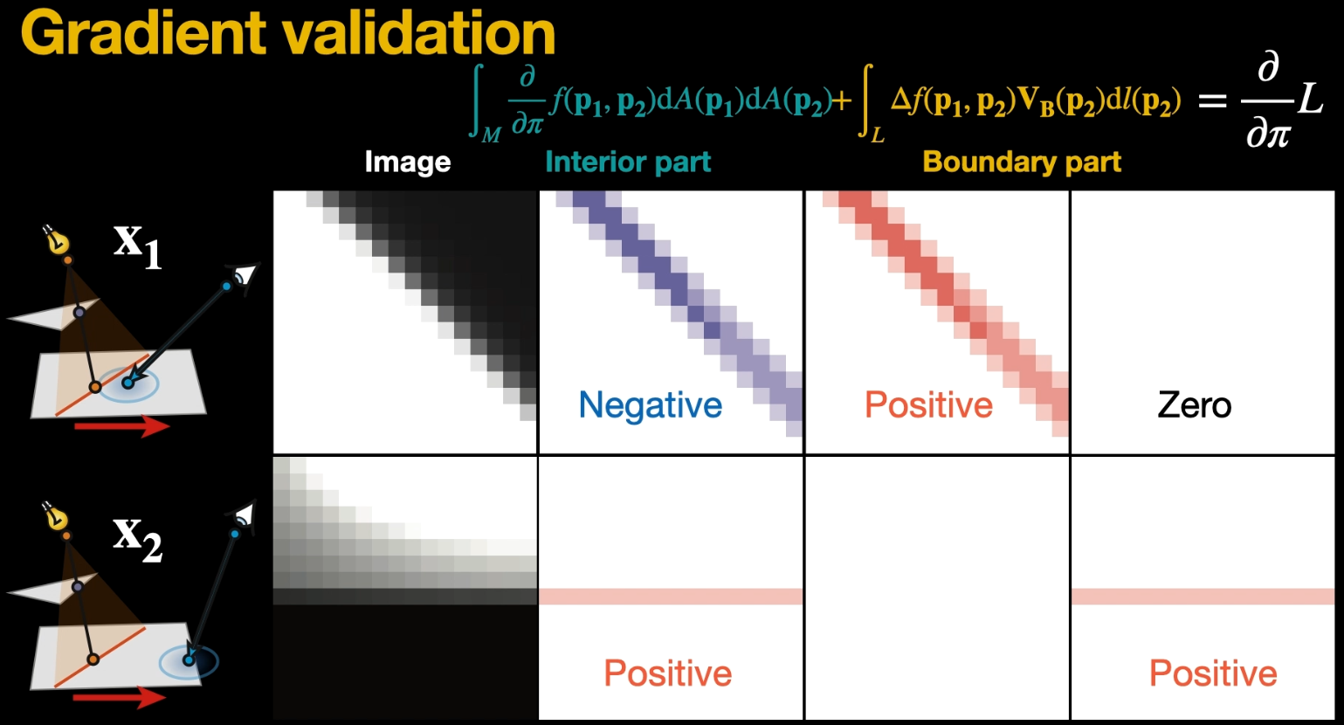
Notes:
let's look at this gradient component in image space
this results aligned with our ground truth expectations

Slide 27
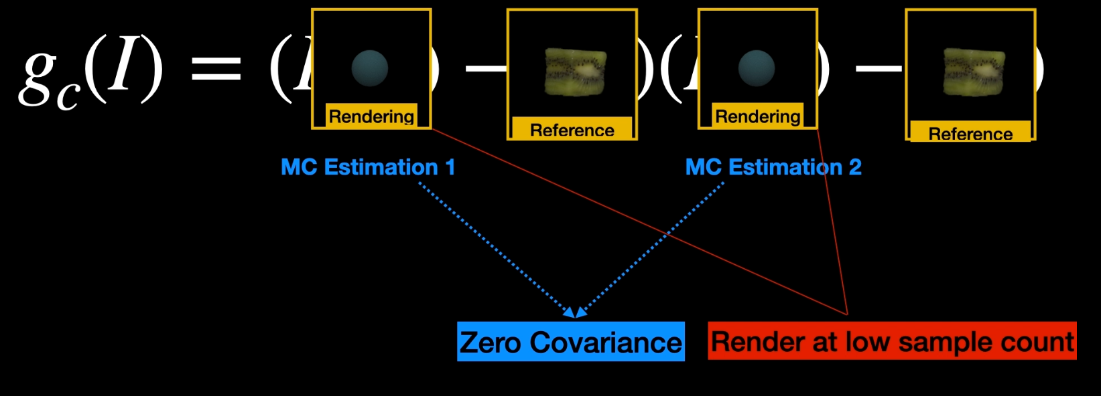
Stochastic Gradient Descent Optimizer
two independent render estimation of images rendered with parameter Pi
Notes:
uses two independent render estimation of images rendered with parameter Pi
this gives zero Covariance
and render at...
which speeds up

Slide 28
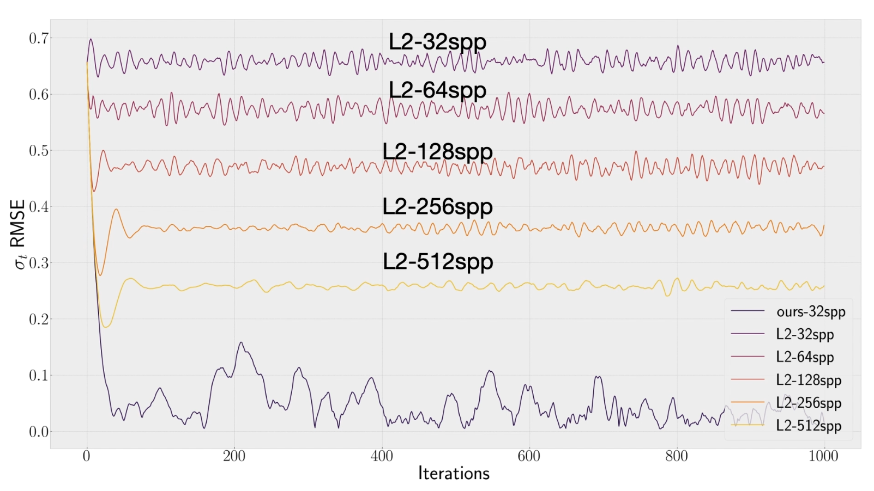
converges to low error at a very low sample rate!
Notes:
a plot of parameter error with different loss function
L2 functuion: have to use a high sample count to have low error
the author’s method the optimization converges to low error at a very low sample rate

Slide 29
Experiments&Results

Slide 30
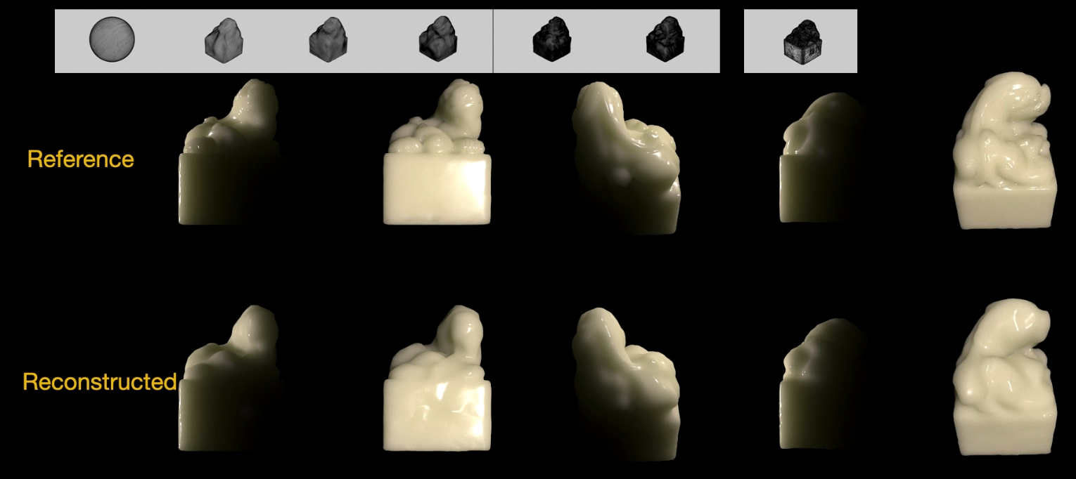
Example of reconstructing the shape
Render in PSDR using BSSRDF; Fit in PSDR-CUDA using BSSRDF, Reconstruct shape only
Results
Notes:
an example of geometry reconstruction with a bssrdf

Slide 31
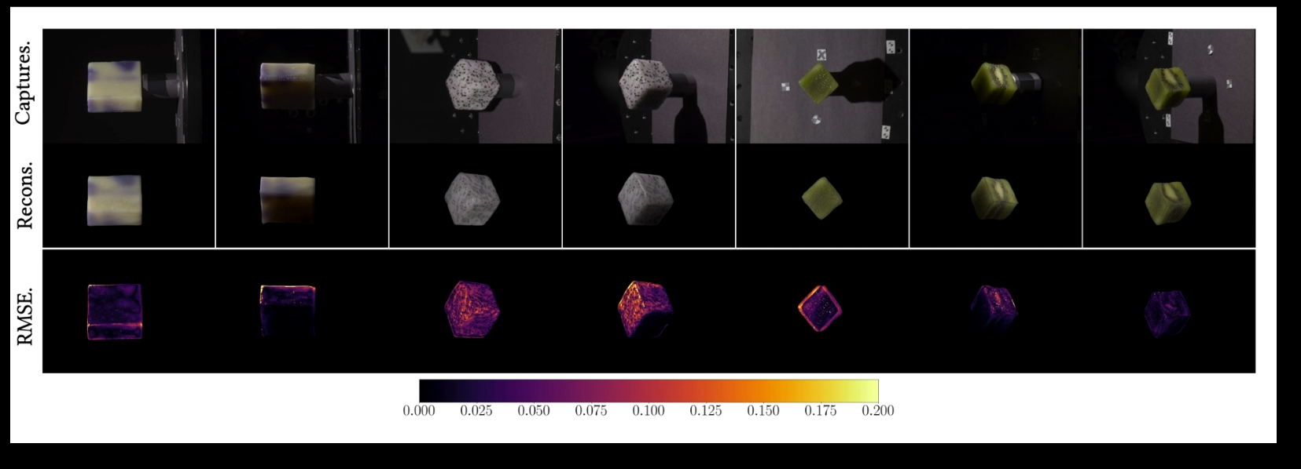
Real Data
Results
scattering properties and surface roughness
Notes:
objects we reconstructed from real photos
reconstructed 2D textures of scattering properties and surface roughness

Slide 32
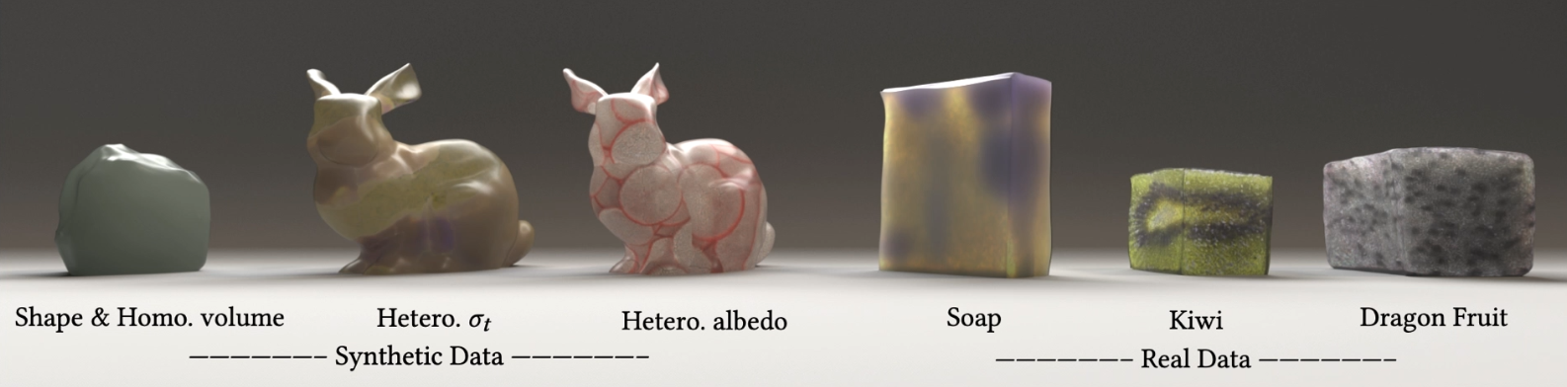
Render reconstructions in global illumination
Results
Notes:
we can reconstruct objects in any environment

Slide 33
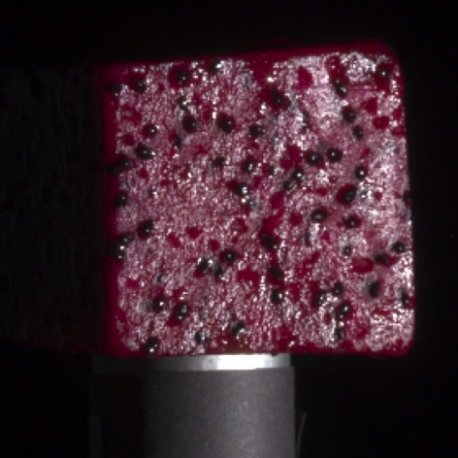
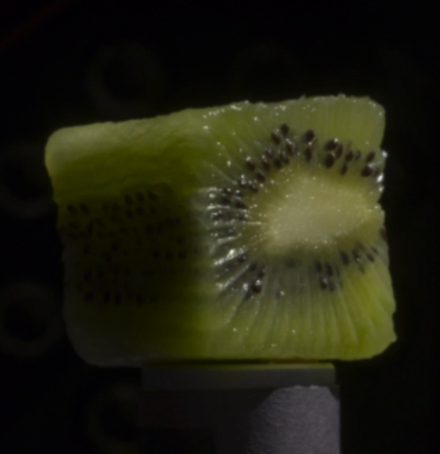
Future Work
1. High-frequency specular details from real-world data
2. Difficulties in reconstructing texture beneath the surface
Notes:
it's it's hard to reconstruct surface details from specular Reflections when structure below the surface cause parallx this

Slide 34
1.Reconstructed real translucent objects with BSSRDF
2.Accurate appearance model helps shape reconstruction.
3.We can use noisy rendering in SGD, as long as the gradient estimation is unbiased.
Conclusion
Notes:
1.successfully reconstruct translucent object using differentiate rendering with bssrdf

Slide 35
Thank you!
(References: All of the pictures and formulas are from the authors’ paper and video)

Slide 36
Quiz
Student ID:
Name:
1. By using Differentiable Rendering, we( )
A. need special shape, no special lighting
B. need no special shape, no special lighting
C. need special shape, special lighting
D. need no special shape, special lighting
2. Which one isn't the feature of the model?( )
A. Highly scattering objects
B. Thick objects
C. Transparent and homogenous
D. spatially varying patterns

